Slide 1
Digestive system
Small intestine Lecture
Dr. Fatin Latef

Slide 2
Small intestine
7m of length is the longest region of the alimentary tract
anatomically in to three regions, duodenum, jejunum and ileum , these segments have most histologic features in common and are discussed together.
it digests food material and absorbs end products of the digestive process..
to perform its digestive functions, the first region of the small intestine, the duodenum, receives enzymes and alkaline buffer from the pancreas and bile from the liver, additionally, epithelial cells and glands of the mucosa contribute buffer and enzymes to facilitate digestion.

Slide 4
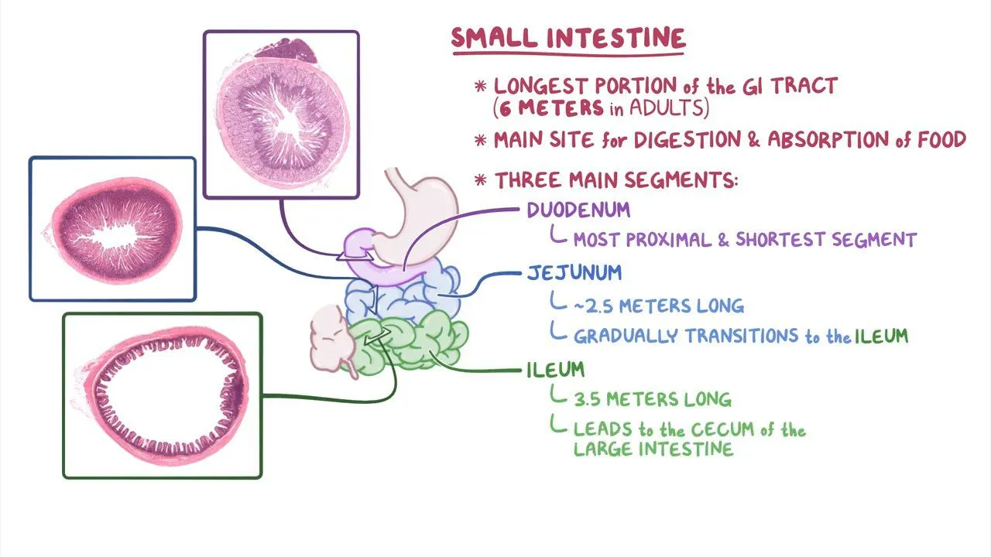

Slide 5
Modifications of the luminal surface:
The luminal surface of the small intestine is modified to increase its surface area, three types of modifications have been noted:
1-Plicae circulars (Valves of Kerckring), are transverse folds of the submucosa and mucosa that form semicircular to helical elevations. These are permanent fixtures of the duodenum and jejunum and end proximal half of the ileum, the increase the surface area by a factor of 2-3.
2- Villi, are epithelial covered, finger- like or oak leaf- like protrusions of the lamina propria. The core of each villus contains capillaries loops, lymphatic channels and few smooth muscle fibers, embedded in loose c.t and rich in lymphatic cells.

Slide 6
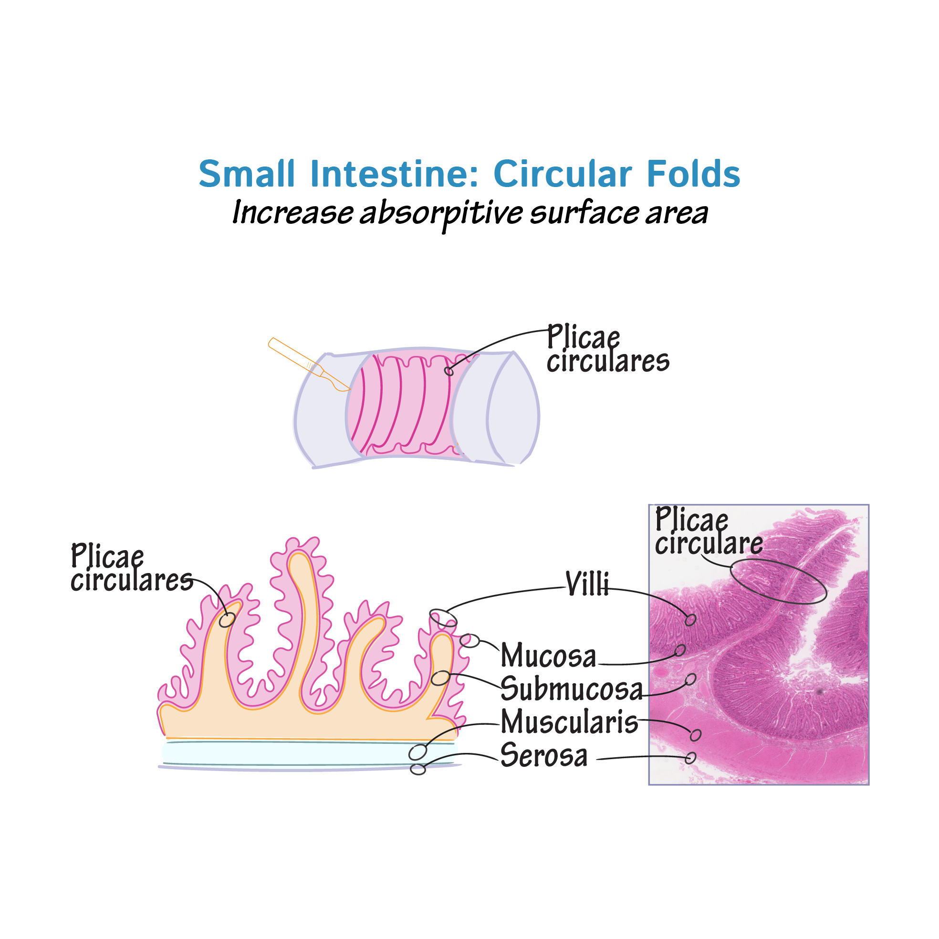

Slide 7
it are permanent structure, their numbers are greater duodenum than in the jejunum or the ileum. Villi increase surface area of the small intestine by a factor of 10.
3-Microvilli, modifications of the apical plasma lemma of the epithelial cells covering the intestinal Villi, increase the surface area of small intestine by a factor of 20.
Thus, the three types of intestinal surface modifications in crease the total surface area available of absorption of nutrients by a factor of 400-600.

Slide 8
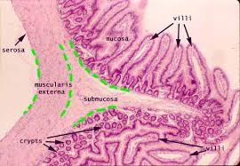

Slide 9
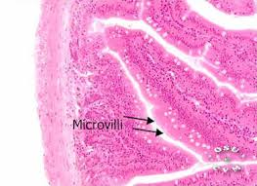

Slide 11
Intestinal mucosa:
Composed of three layers, simple columnar epithelium, lamina propria and muscularis mucosa.
1-Epithelium: the simple columnar epithelium covering the Villi and the surface of the intervillar spaces is composed of surface absorptive cells, goblet cells and DNES cells.
Surface absorptive cells:
-the most numerous cells of the epithelium.
-they are tall cells, have basally located oval nuclei, their apical surface present a brush boarder.
-the principle functions are terminal digestion and absorption of water and nutrients, also transport the bulk of the absorbed nutrients in to the lamina propria for distribution to the rest of the body.

Slide 12
-
have the microvilli, covered with a thick glycocalyx layer which act to protect of microvilli from the auto digestion also help in terminal digestion for dipeptides and polyaccharides in to their monomers by its enzymatic components.
-the cytoplasm is rich in organelles, especially smooth and rough endoplasmic reticulum and Golgi complex.
Goblet cells:
-unicellular glands, the duodenum has the smallest number of goblet cells their number increase toward the ileum.
-manufacture mucinogen.
-protective layer lining the lumen

Slide 13
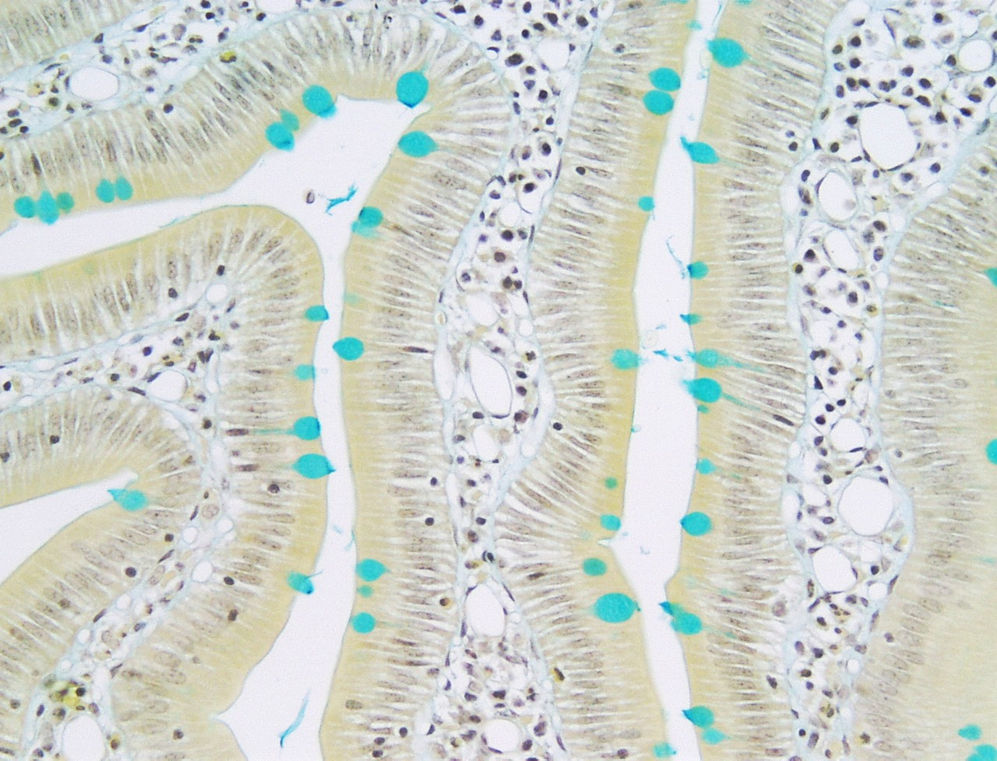

Slide 14
DNES cells:
-produce the paracrine and endocrine hormones.
-1% of cells covering the Villi and intervillar surface of small intestine are composed of DNES.
2-Lamina propria:
-loose c.t from the core of the Villi, which like trees of a forest rise above the surface of the small intestine.
-the remainder of the lamina propria, extending down to the muscularis mucosa, is compressed in to thin sheets of highly vascular zed c.t by numerous tubular intestinal glands (Crypts of Lieberkuhn).
-rich by lymphoid cells.

Slide 15
Crypts of Lieberkuhn
-simple tubular glands, open in to the intervillar spaces.
-composed of surface absorptive cells, goblet cells, regenerative cells, DNES cells and paneth cells.
-surface cells and goblet cells occupy the upper half of the gland.
-the basal half of the gland has no surface absorptive cells and a few goblet cells, instead , most of the cells are regenerative cells DNES cells and Paneth cells.
*Regenerative cells:
- are stem cells that extensively proliferate to repopulate the epithelium of the crypts, mucosal surface and villi.

Slide 16
-narrow cells.
-display few organelles but many free ribosome's, their single, basally located, oval nuclei.
*Paneth cells:
-clearly distinguishable because of the presence of large, eosinophilic, apical secretory granules.
-pyramid-shaped cells.
-occupy the bottom of the crypts of Lieberkuhn.
-manufacture the antibacterial agent lysozyme.
-display well developed Golgi complex, a large complement of RER, mitochondria and large apical secretory granules.

Slide 17
Muscularis Mucosa:
-composed of inner circular layer and outer longitudinal layer of smooth muscle cells.
-muscle fiber from the inner circular layer enter the villus and extend through its core to the tip of the c.t.
-during the digestion, theses muscle fibers rhythmically contracts, shortening the villus several times a minute.
Sub mucosa
The submucosa has larger blood and lymph vessels and the diffuse, interconnected neurons of the submucosal (Meissner) nerve plexus .

Slide 18
The proximal part of the duodenum has in the submucosa and mucosa large clusters of
branched tubular mucous glands, the duodenal (or- Brunner) glands, with small excretory ducts opening among the intestinal crypts. Mucus from these glands is distinctly alkaline (pH 8.1-9.3), which neutralizes chyme entering the duodenum from the pylorus, protecting the mucous membrane, and bringing the intestinal contents to the optimum pH for pancreatic enzyme action.
In the ileum both the lamina propria and submucosa contain well-developed mucosa-associated lymphoid tissue (MALT), consisting of the large lymphoid nodule aggregates known as Peyer patch underlying the epithelial M cells.

Slide 19
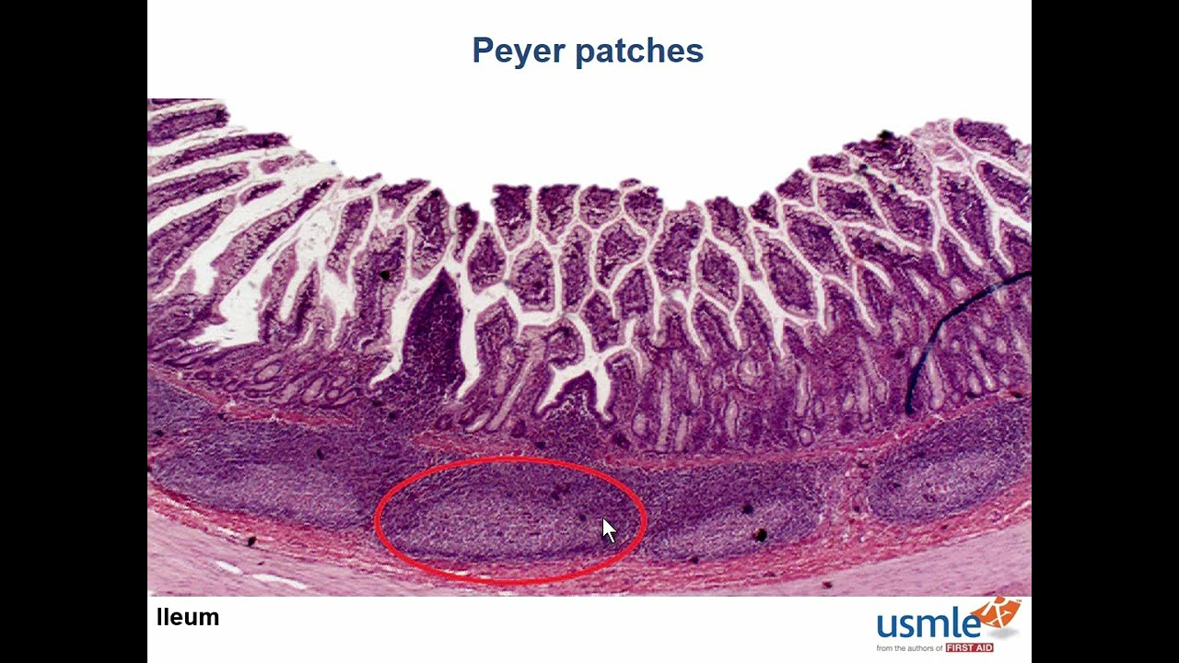

Slide 21
Muscularis externa
muscular is is well developed in the small intestine, composed of an internal circular layer, an external longitudinal layer, and
between them the neurons of the myenteric (Auerbach) nerve plexus which produce peristalsis . Neurons of both the submucosal and myenteric plexuses are largely autonomic and collectively make up the large enteric nervous system. The small intestine is covered by a thin serosa with mesothelium continuous with that of mesenteries.

Slide 22
Regional Differences:
-the duodenum is the shortest segment of the small intestine.
-the duodenum receives bile from the liver and digestive juices from the pancreatic duct.
-the Villi in duodenum differs from the jejunum and ileum in that are broader, taller, and more numerous, it has fewer goblet cells than other segments.
-there are Brunner's gland in its sub mucosa.
-the Villi of the jejunum are narrower, shorter, and sparser than those of the duodenum.
-the villi of the ileum are the sparest, shortest and narrowest of the three regions of the small intestine.

